Slide 1
Digital Image Steganography: Survey and analysis of current methods.
Amal Al Mouhamed
Computer Security
24-10-2016

Slide 2
What is Steganography
Communicating secret data multimedia carrier: image, audio, video.
Goal is to conceal existence of embedded data.
Point of attack is not evident.
Objectives: undetectability, robustness, capacity of hidden data.

Slide 3
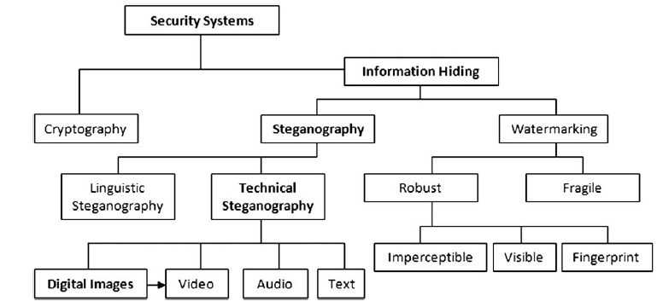
Information Hiding Techniques

Slide 4
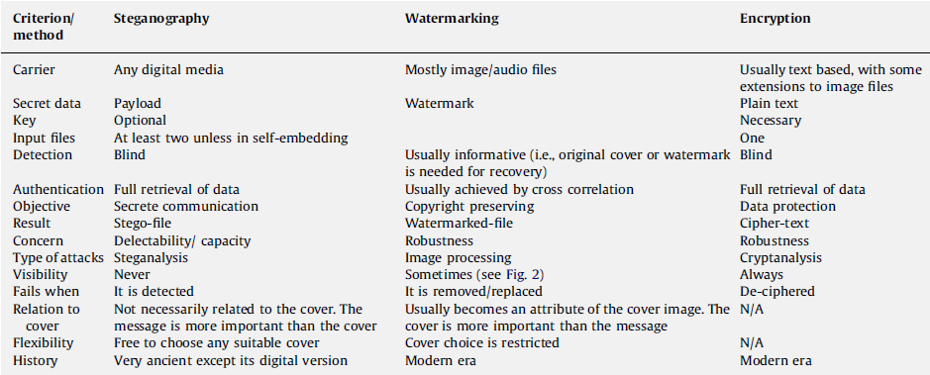
Comparison of Techniques

Slide 5
Ancient Steganography
Greek for “Covered Writing”
5th Century BC: tattoo on slave head
1200 years ago, ancient Arabic manuscripts secret writing
500 years ago, Italian mathematician: Chinese method of secret writing: holes on cover paper.
WWII Nazis: microdots, invisible ink, null ciphers.
1945: Morse code in drawing

Slide 6
Digital Steganography
In [10] earliest method for Steg: embedding into 4 least significant bits (LSB).
Cyber crime benefitted: terrorists.
Difficult to control
In [3], 3 million images scrutinized by University of Michigan: found nothing.
Embedding in: video, audio, HTML, exe, XML

Slide 7
Steganography Applications
Copyright
Improve robustness of image engines.
IDs: details embedded into image
Video-audio synchronization
Company safe circulation of secret data
TV broadcasting
TCP/IP packets (analyze network traffic)
Medical Imaging systems
Fujitsu: encode then decode data using phone camera (hue, saturation, value: HSV).
Digital document forensics.

Slide 8
Steganography definitions
Cover image: original
Steg image: result image
Key: seed to encyrpt message
Images: GIF, JPEG,PNG, BMP
Steg-analysis: steg attack or identifying steg image

Slide 9
Exploiting Image format: Naive
Append secret message in JPEG after EOF.
Produce steg-image
Or append secret message in metadata.
Very easy to attack.
Possible to use metadata analysis to prevent child pornography.

Slide 10
Image Spatial Domain
Encoding at LSB level
1st LSB or 4th LSB
4th LSB more visual distortion
(a)Thecovercarrier (b) 1st–4thLSBsof(a),(c)theimagetohide(d)stego-image1stLSBs replaced with 1stMSBs of(c),(e)LSBs of(d),(f)stego-image1st–4thLSBs replaced with 1st–4th MSBs of(c), (g)LSBsof(f), (h)difference between(a)and (d), (i)difference between(a)and(f),(j)hiddenimageextractedfrom(d),(k)hiddenimageextractedfrom(f).

Slide 11
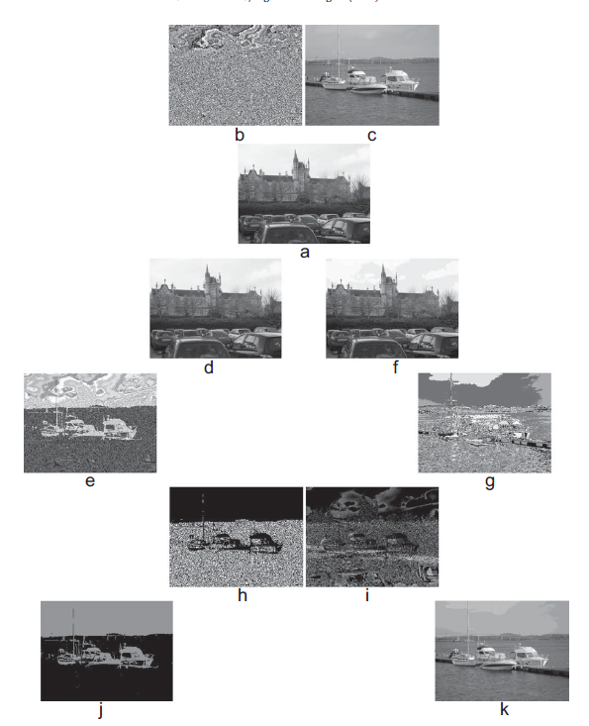

Slide 12
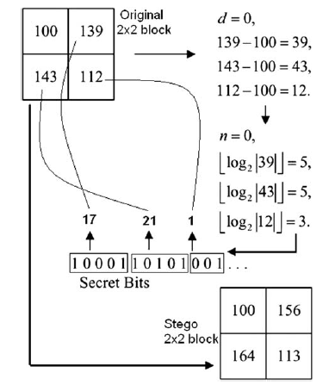
In [34] downsampled input image into ½. Modified interpolation method to upsample result back. Impossible not to loose info.

Slide 13
Image frequency domain
Discrete cosine transform used to transform successive sub image blocks into 64 DCT coefficients.
Quantization method: loosen up tightened precision.
Jpeg Image compression.

Slide 14
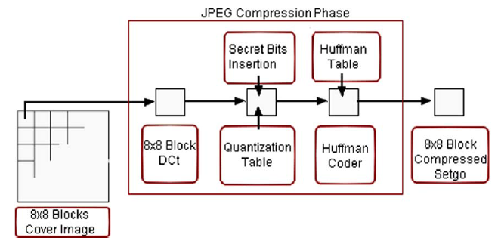
Embedding in frequency domain

Slide 15
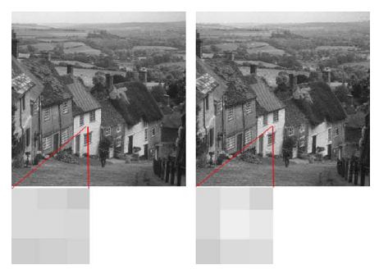
If coefficients not carefully chosen with DCT, will have problem

Slide 16
Adaptive Steganography
Statistics aware embedding
Masking
Model Based
Random Adaptive selection of pixels in cover
Avoid smooth area
Noise areas to embed.
“Life in Noise”- book by Wayner.

Slide 17
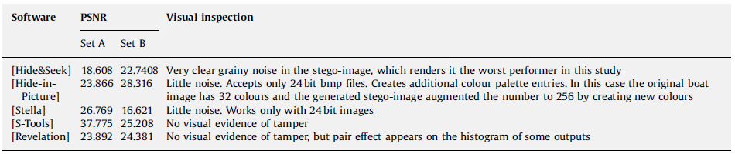
Summary of performance for PSNR peak signal to noise ratio

Slide 18
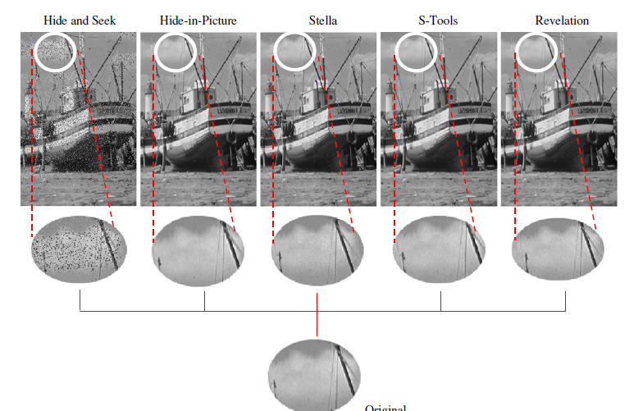

Slide 19
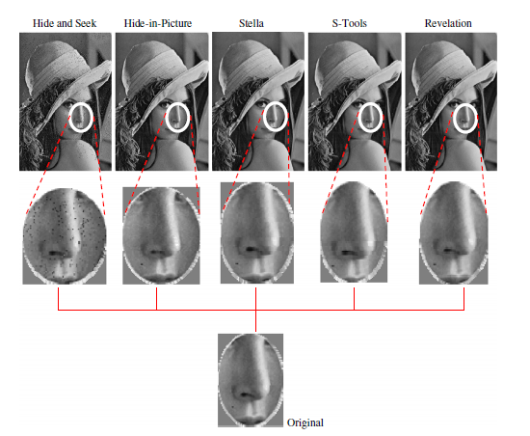

Slide 20
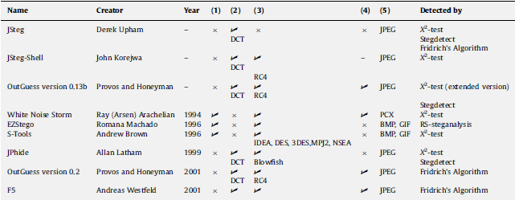
Spatial vs frequency

Slide 21
Analysis
Eliminate attack of comparing: fresh image
Avoid human visual perceptual attack: steg-image must not have visual artifacts.
Alteration up to 4th LSB: not good
Smooth areas: avoid

Slide 22
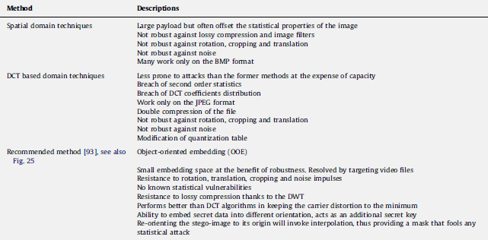

Slide 23
Conclusions
DCT, DWT, adaptive steg: least prone to attacks.
Hidden message should be small.
Image distortion minimum.
Lower payload.
Always has been tradeoff between robustness and payload.
Cover must be carefully selected

Slide 24
Reference
Cheddad, Abbas, et al. "Digital image steganography: Survey and analysis of current methods." Signal processing 90.3 (2010): 727-752.

